Slide 1
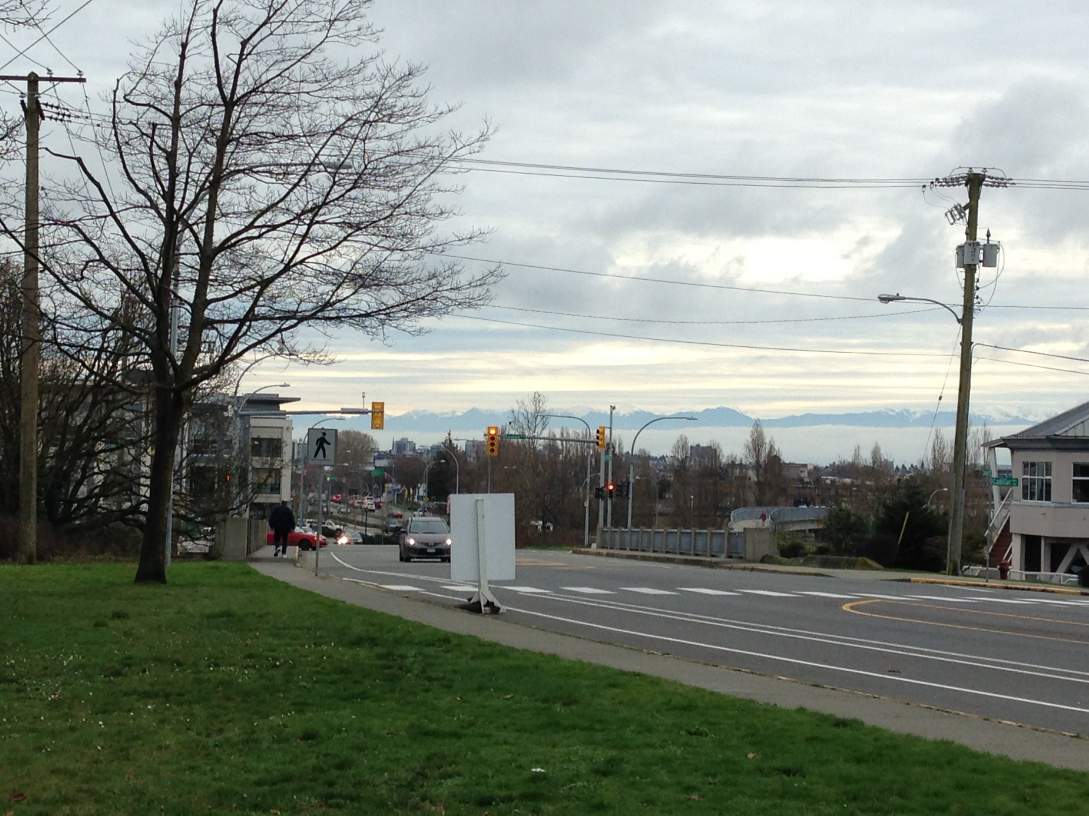
towards SOMEPLACE GREAT

Slide 2
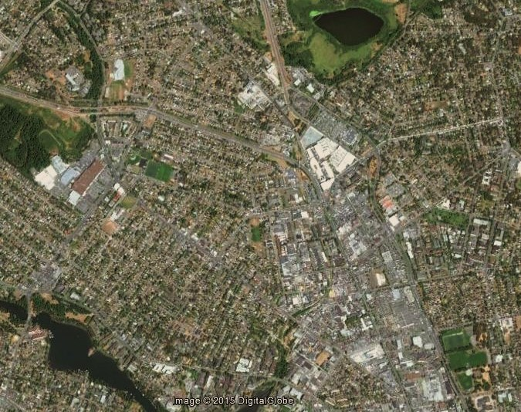
Aerial view
Uptown-Douglas Corridor

Slide 3
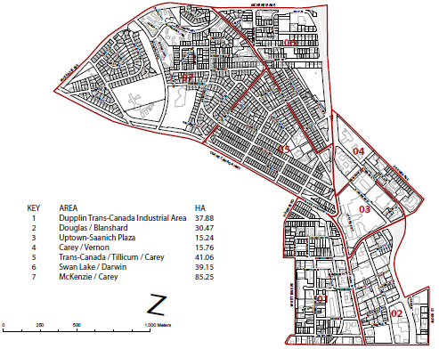
Tillicum Carey, Carey Vernon

Slide 4
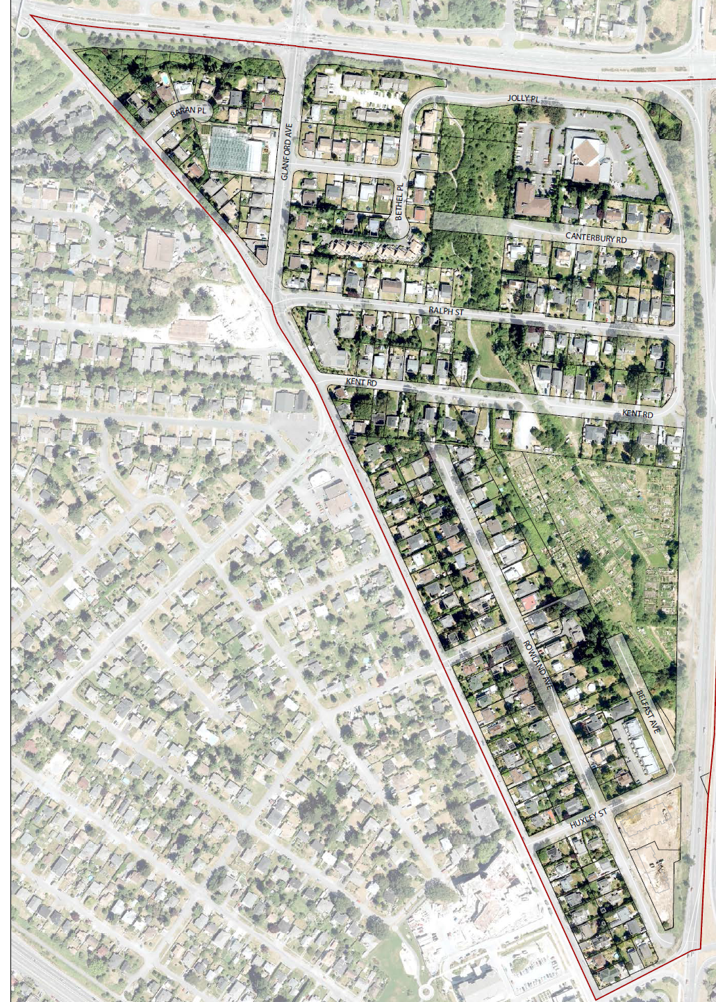
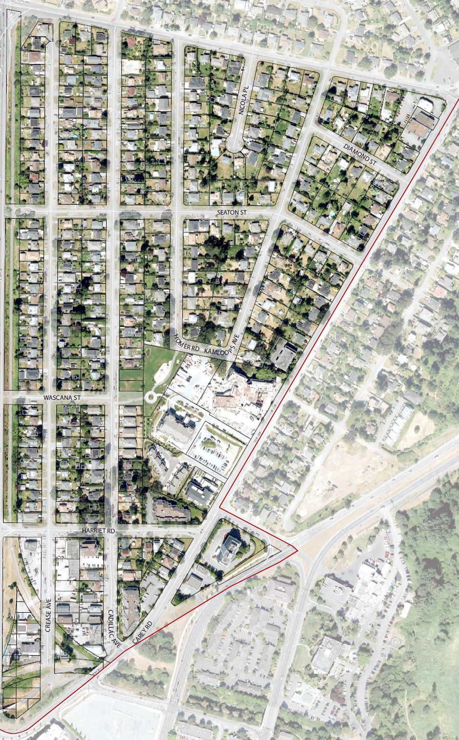

Slide 5
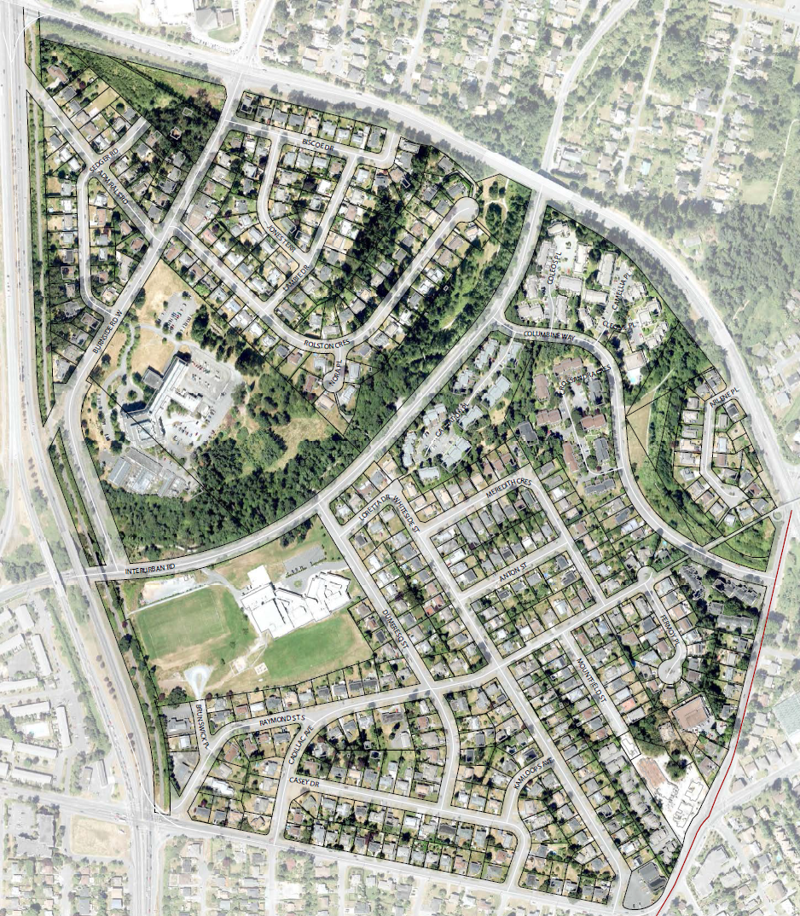

Slide 6
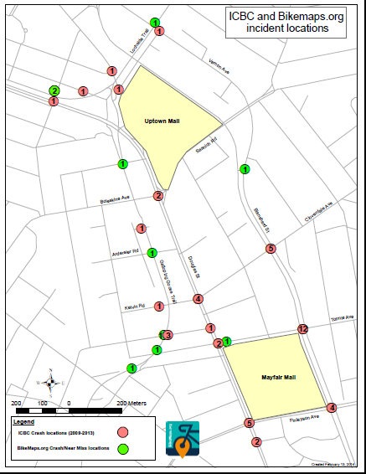

Slide 7
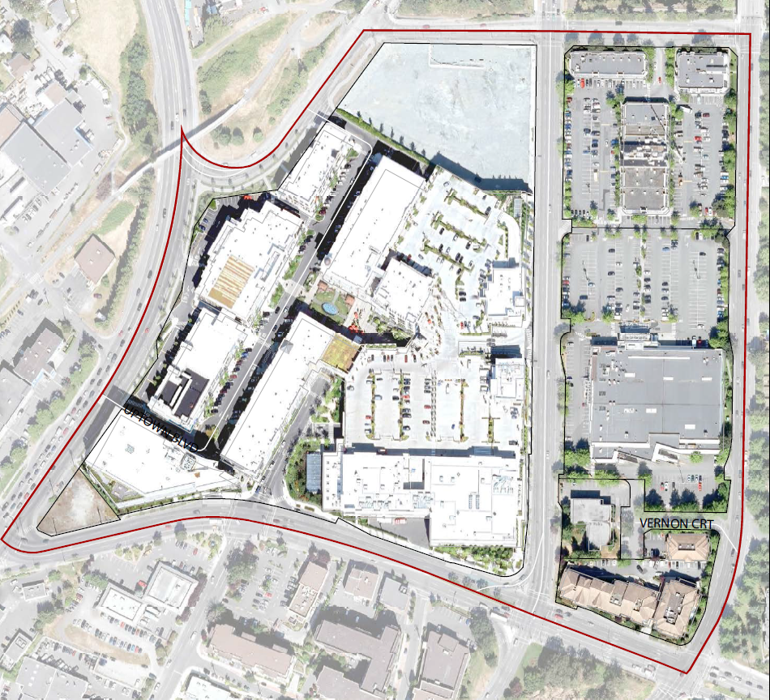
The Uptown-Saanich Plaza is a both a central shopping hub and a major through-way. This presents challenges for pedestrians and cyclists.

Slide 8
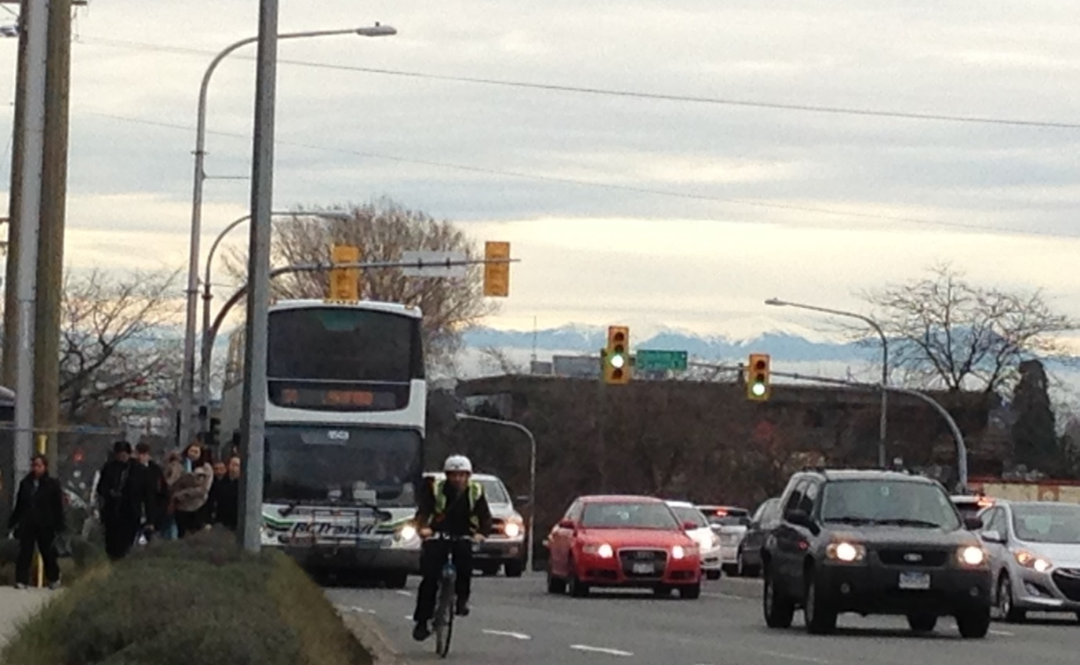
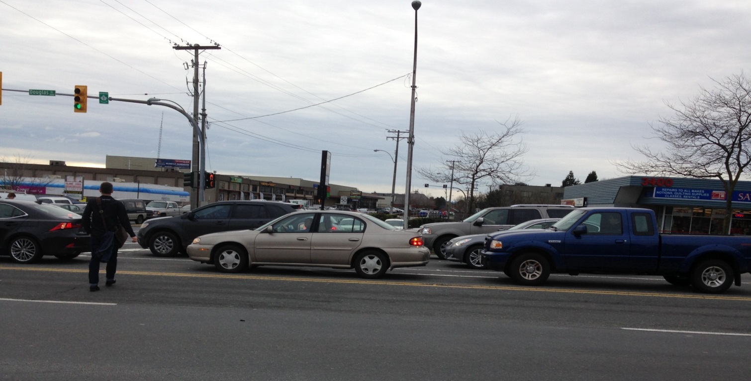
Cyclists and pedestrians interact with vehicle traffic every day.

Slide 9
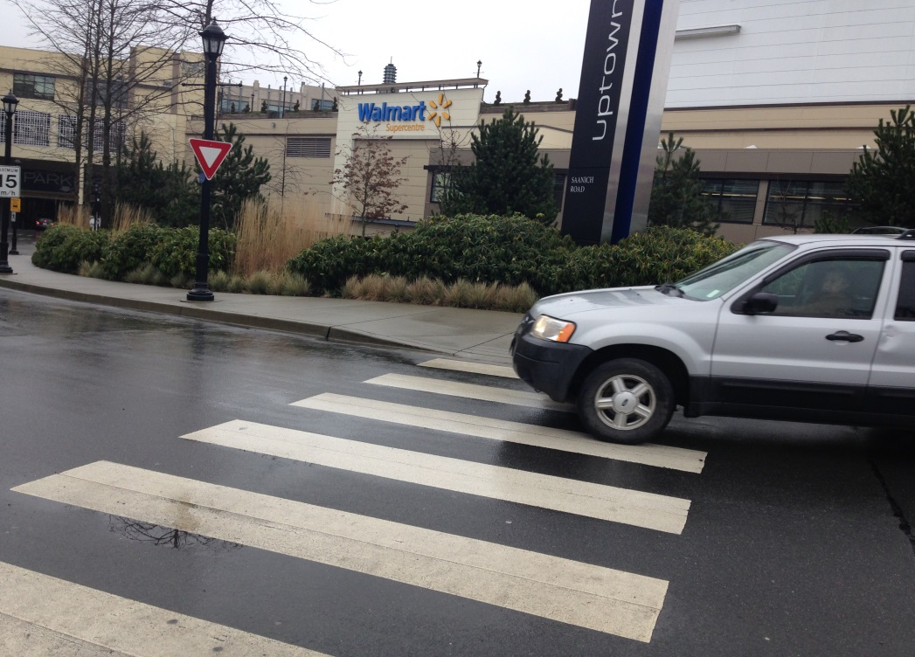
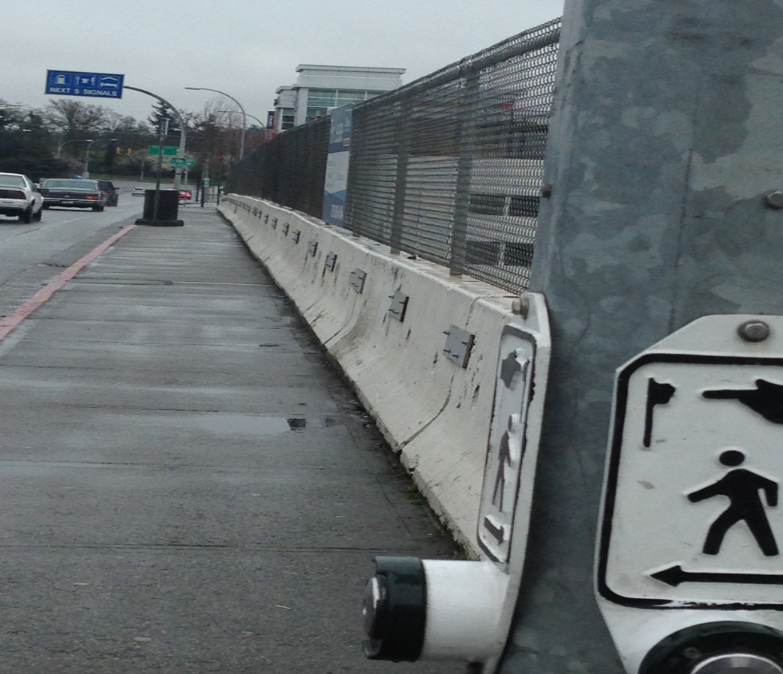
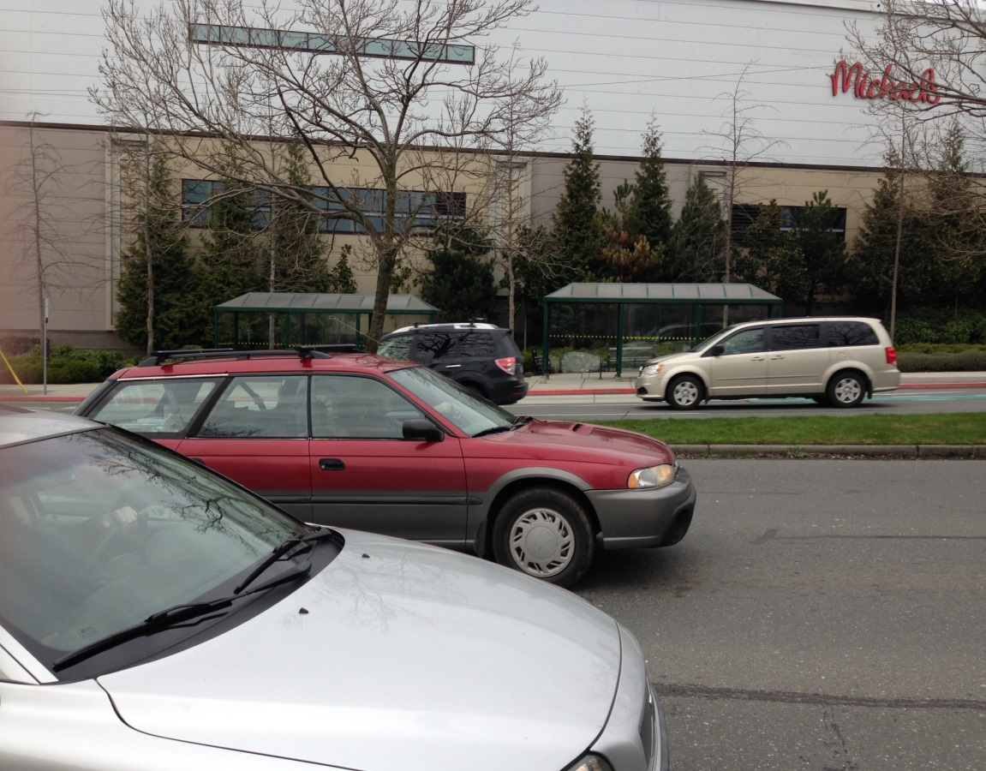

Slide 10
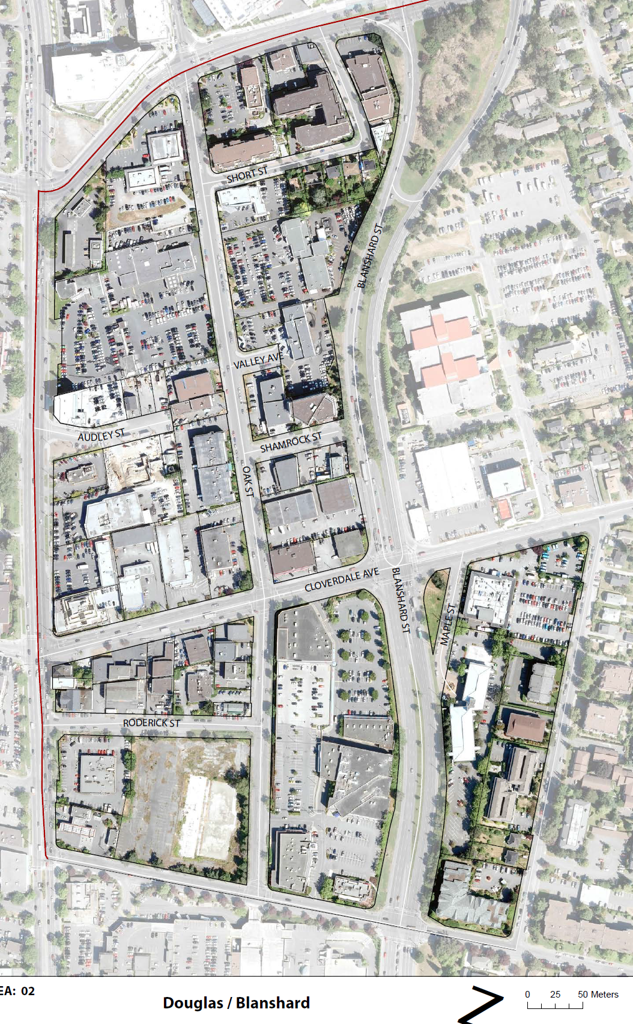
Between Douglas and Blanshard lies Oak Street; a potential pedestrian road with high density housing in the north at Short Street, and commercial/light industrial in the south, near Mayfair

Slide 11
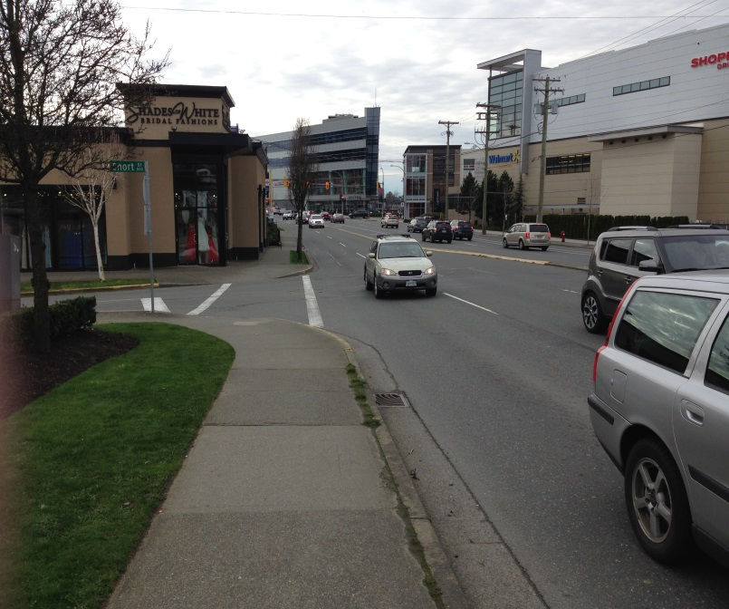
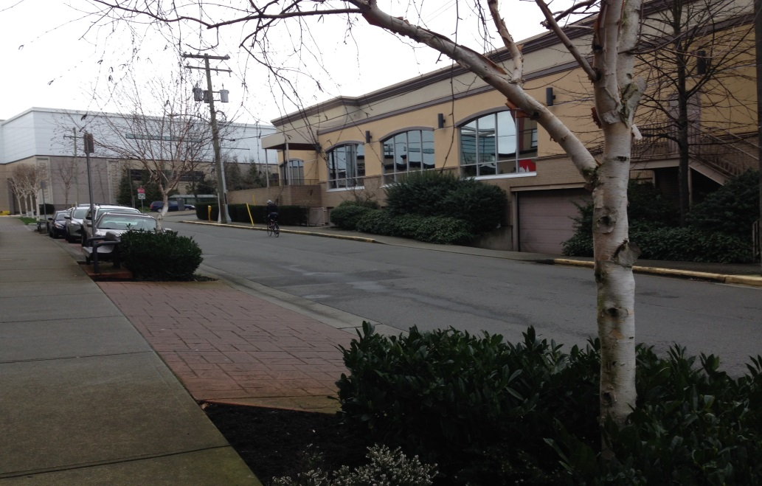
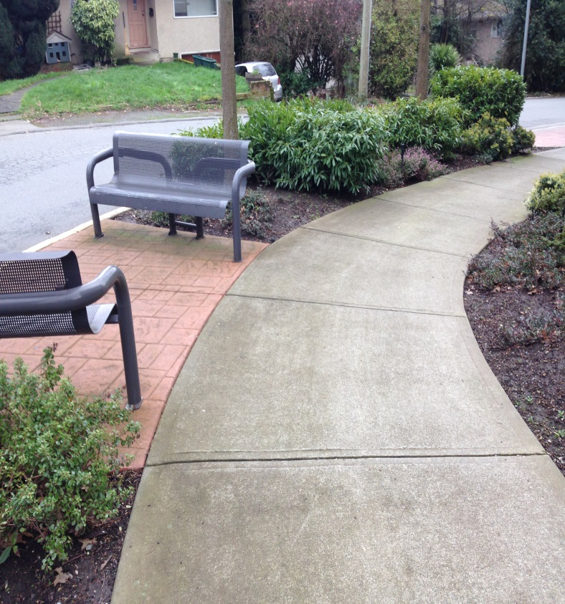
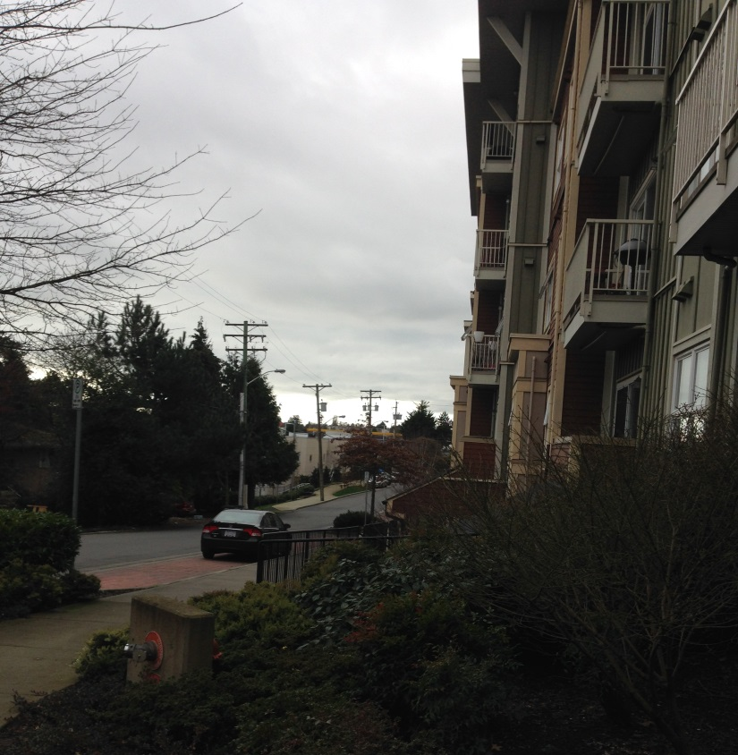
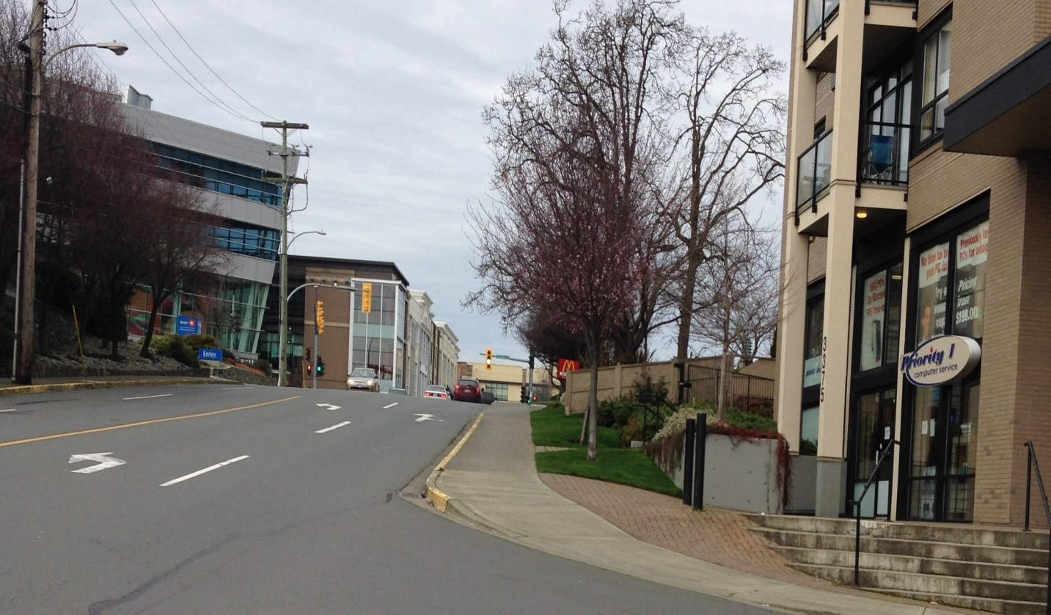
The traffic noise from Saanich Road recedes as you head down Short Street. At the corner path it is almost quiet

Slide 12
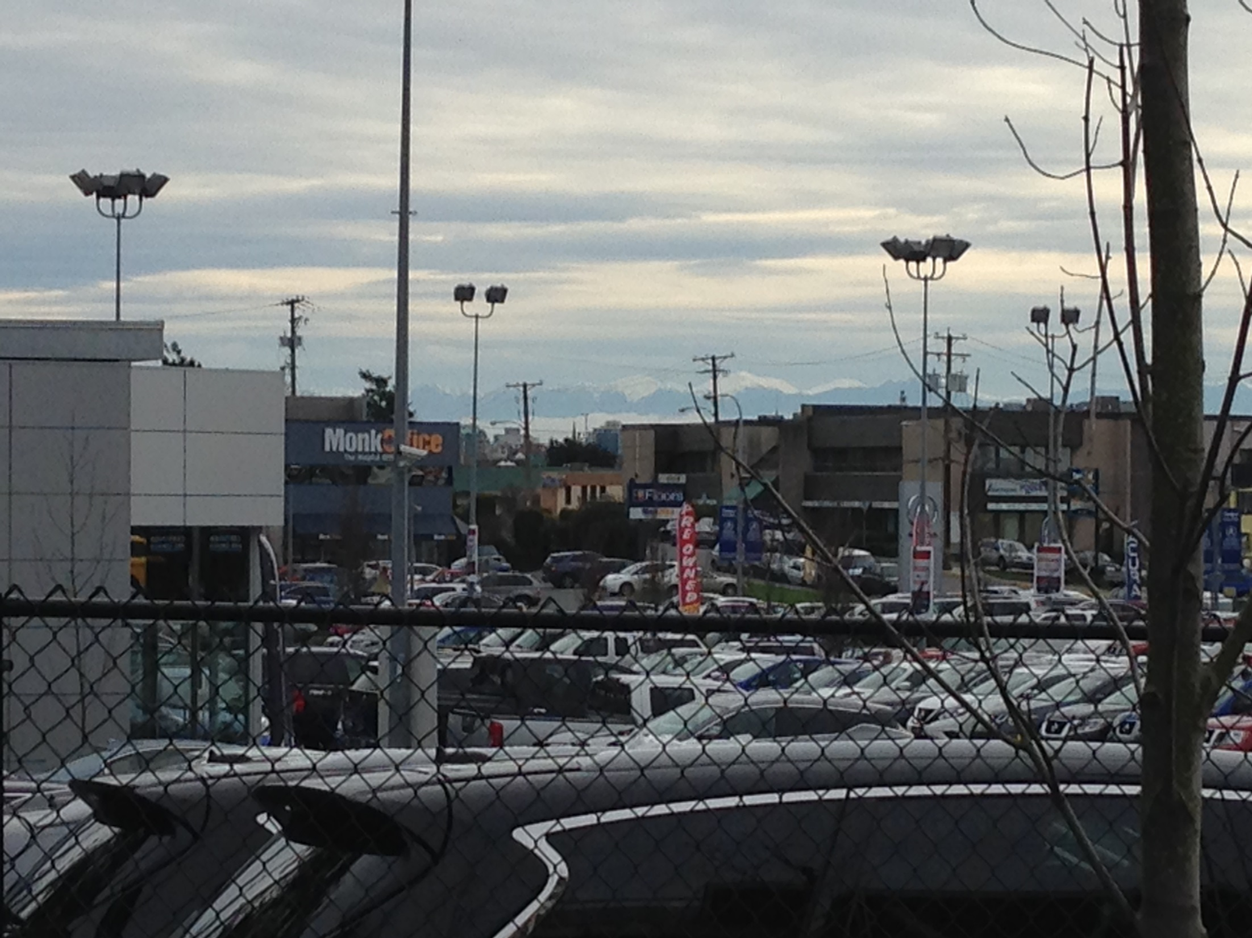
Views of the mountains crop up in unexpected places

Slide 13
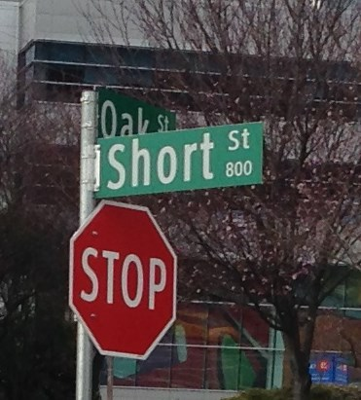
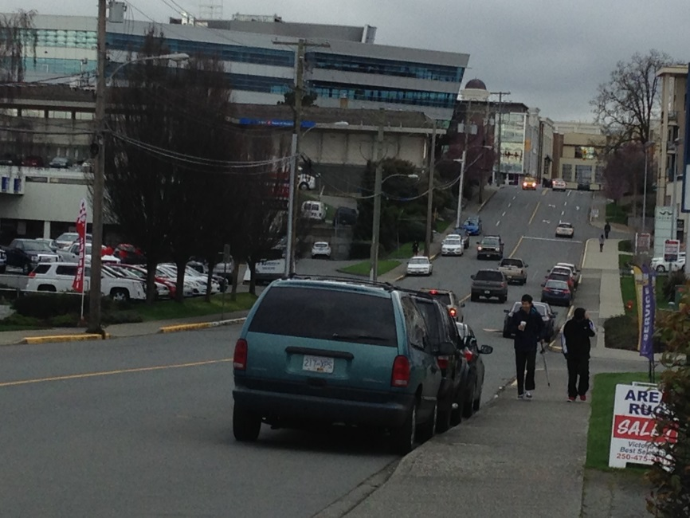
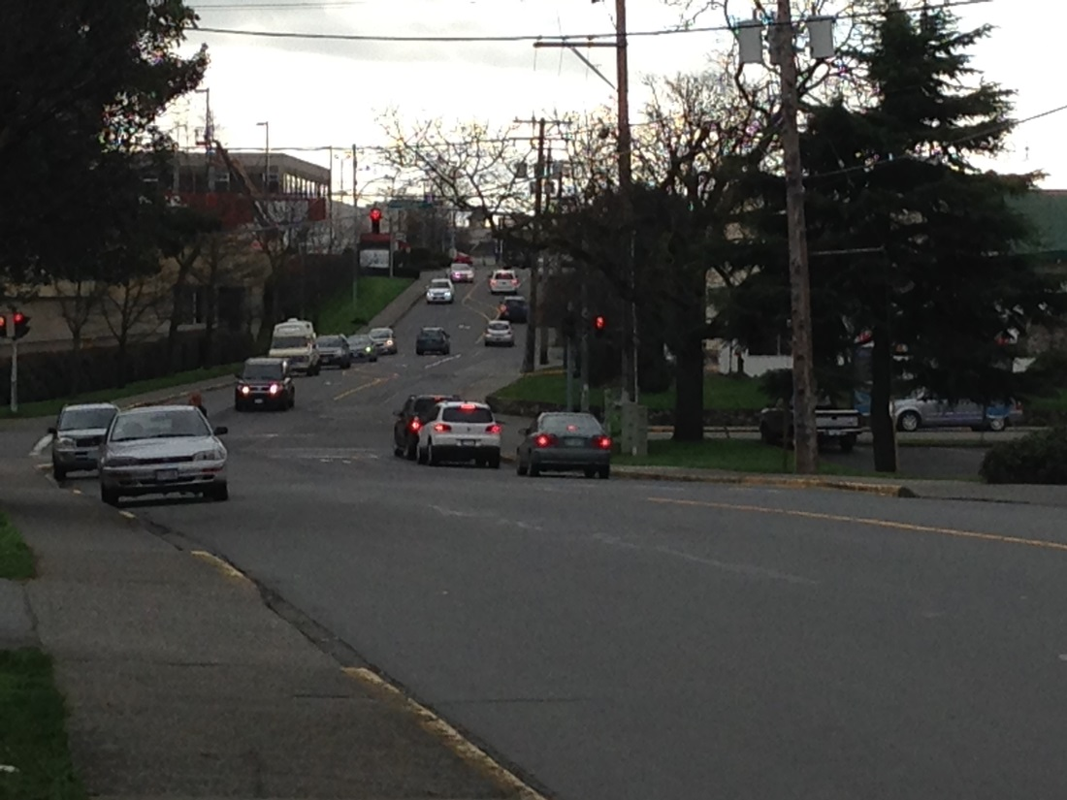
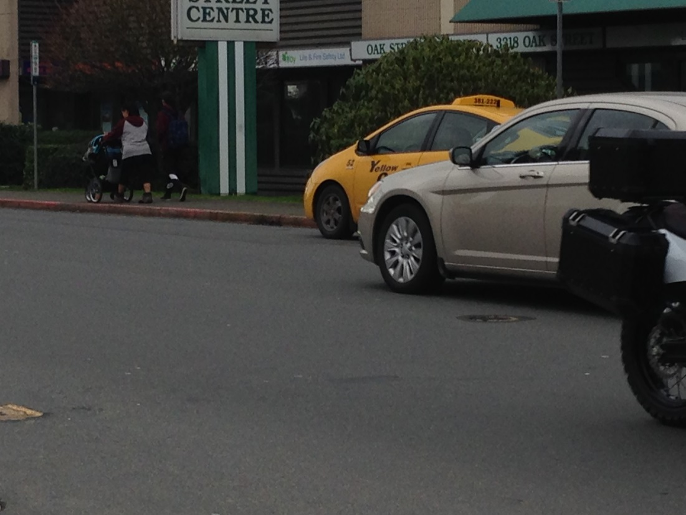
Oak Street runs across a valley between the Saanich Road and Tolmie high points

Slide 14
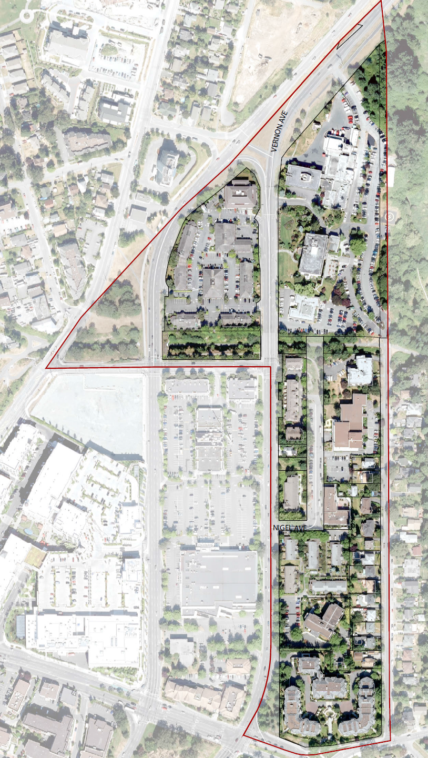
The Swan Lake-Darwin area includes Saanich Centre, City Hall and an enclave of supportive housing and social service resources on Nigel and Vernon.
Swan Lake-Darwin

Slide 15
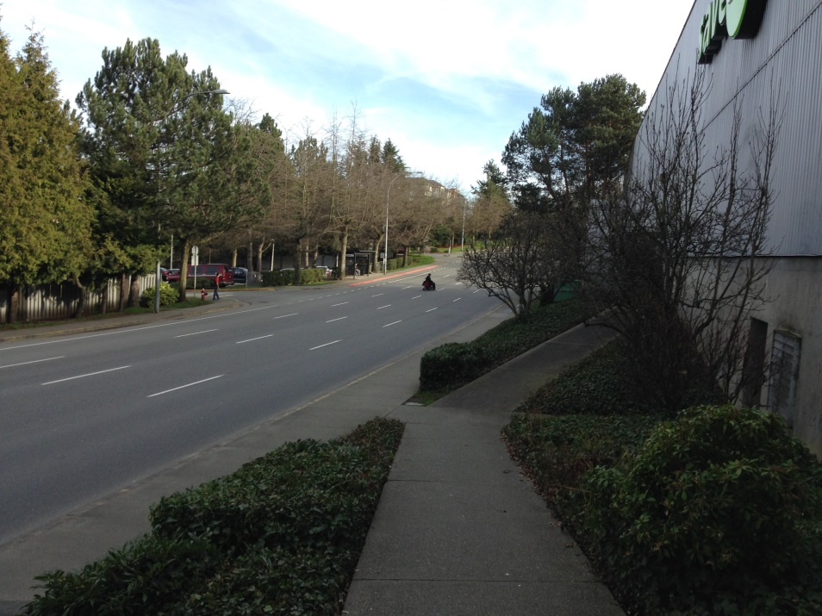
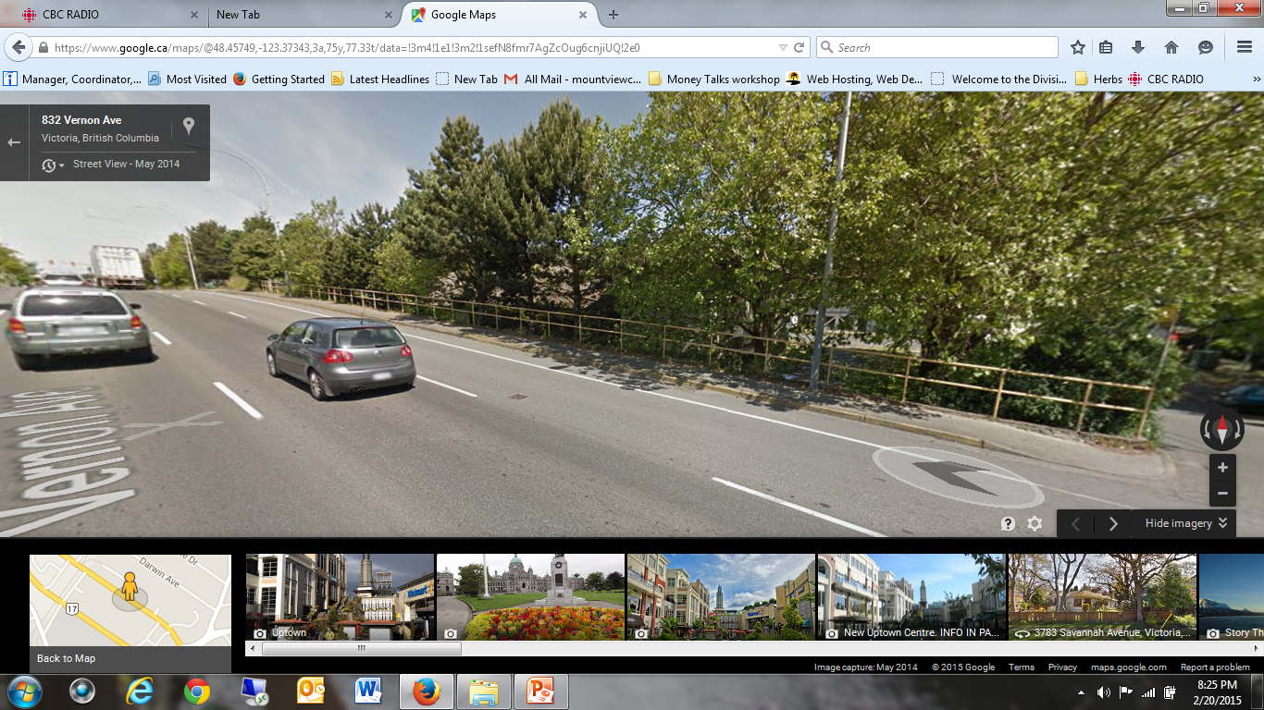
Although a new crossing was placed at Vernon and Ravine, anyone needing a walker or wheelchair has to go far out of their way to cross safely between home and Save-on. Vernon functions as Hwy 17 Northbound at this point, and people daily cross away from the crossings with no protection.

Slide 16
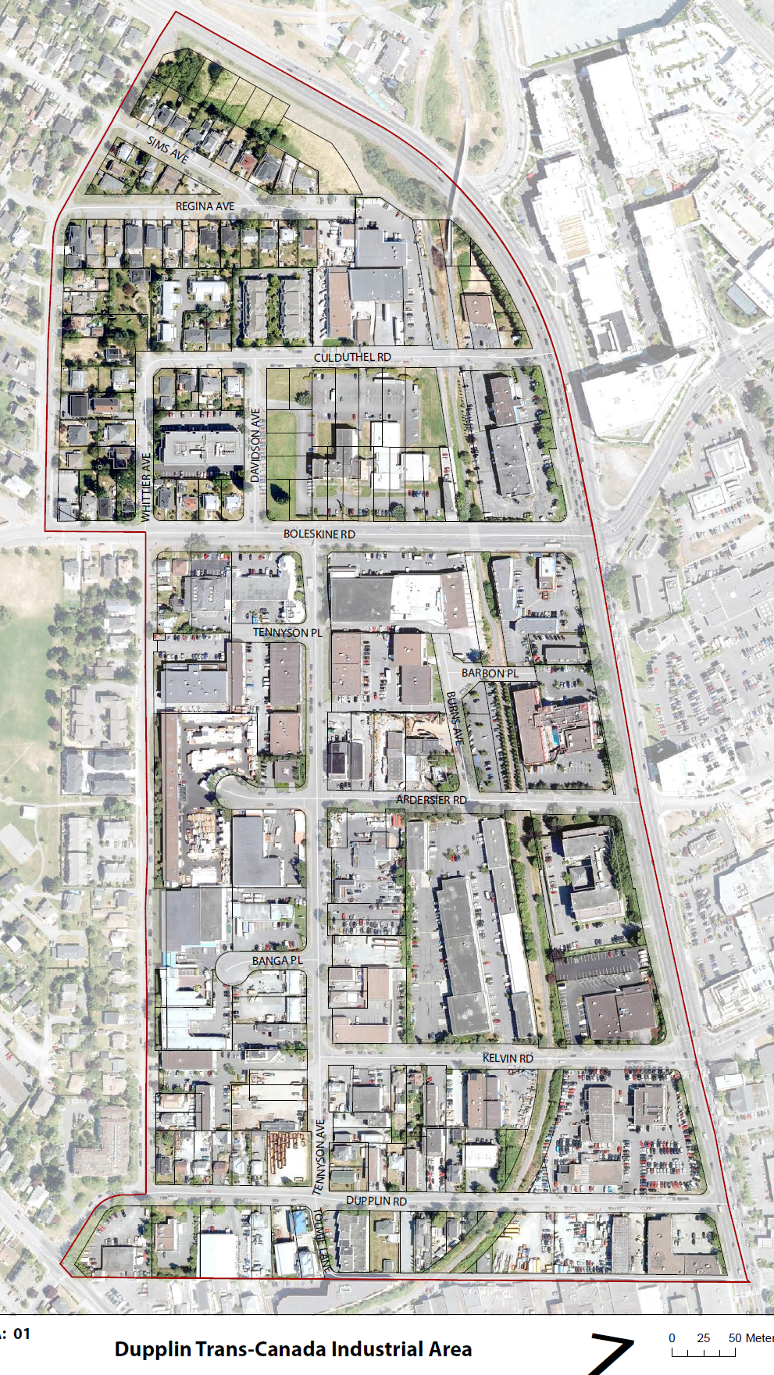
While it is often thought of as an industrial area, the Dupplin-Hwy 1 area West of Douglas has pockets of residential housing as well as warehouses and industry. It is here that many streets cross the Galloping Goose.

Slide 17
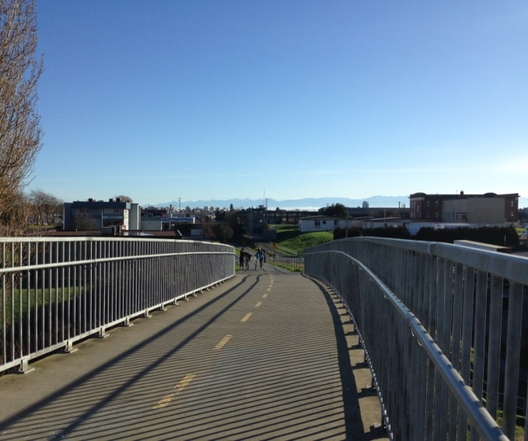
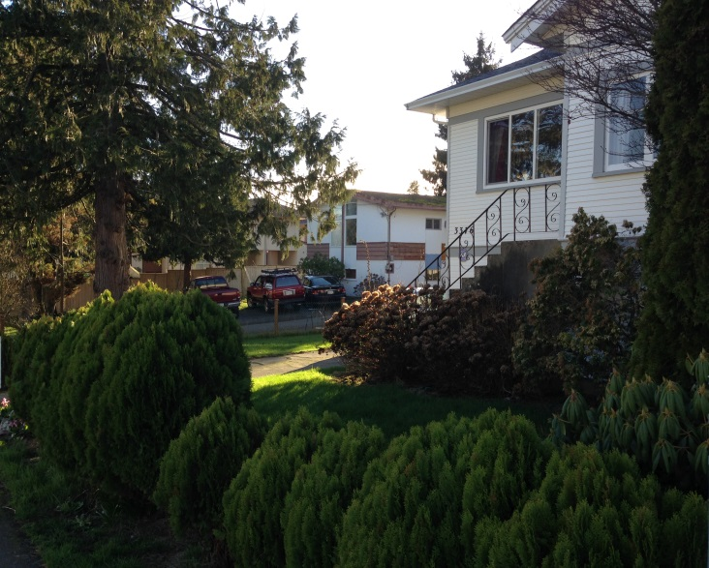
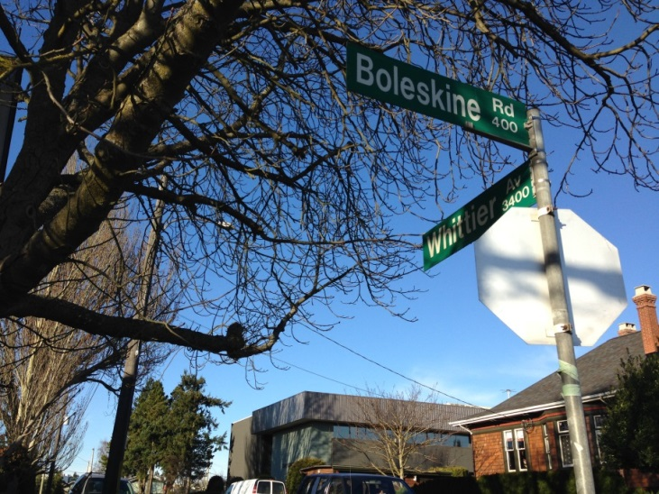
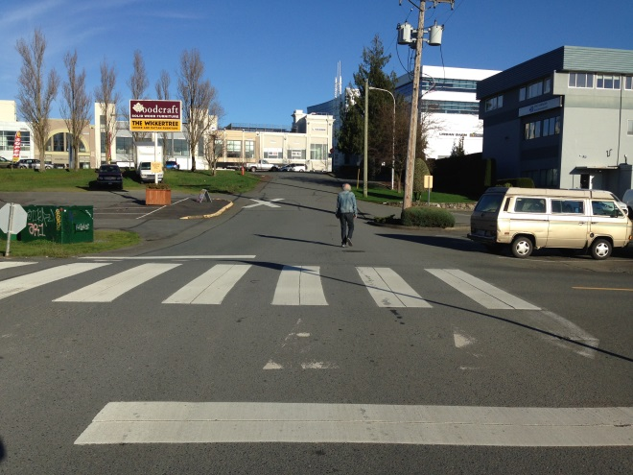
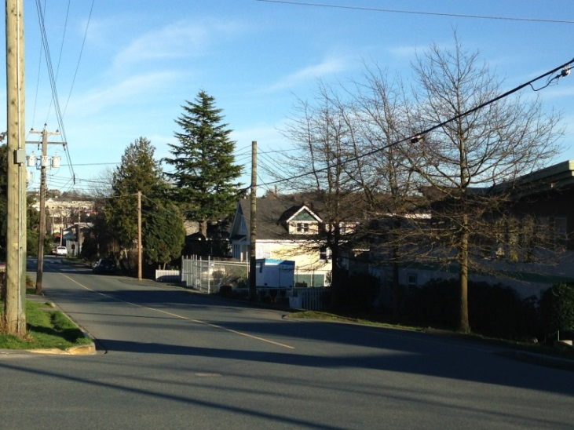
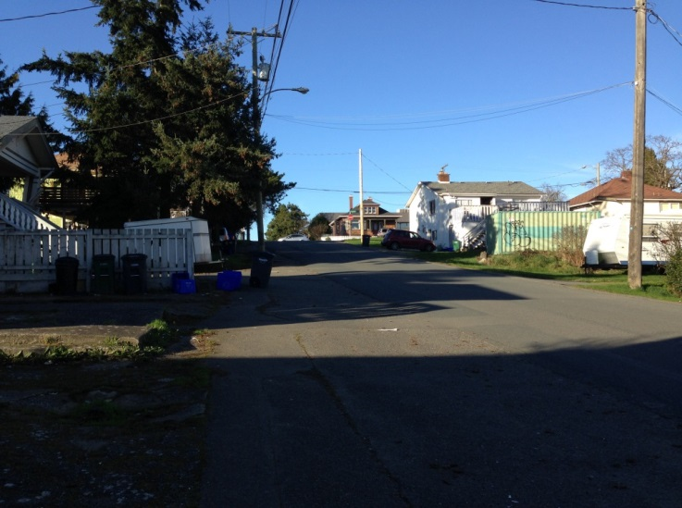
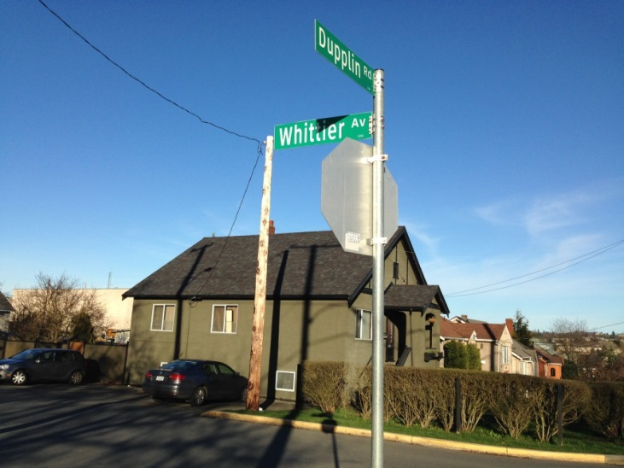

Slide 18
